Slide 1
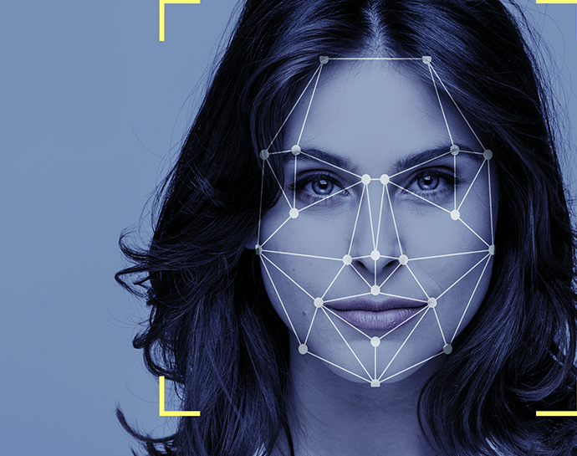
AttendanceEye A Computer Vision Attendance System
By:
Mohsin Ali Mirza – 20k-0353
Waleed Gul – 20k-0259
Mehwish Sameer- 20k - 1085

Slide 2
Acknowledgement
Dr Muhammad Waqas (Supervisor)
Dr Muhammad Rafi (Co-Supervisor)

Slide 3






Table Of Contents
Real Life Demo – Face Detection
Real Life Demo – User Interface
Results
Future Timeline
Dataset Preparation

Slide 4

Data Collection
1: Permission Acquisition
4: Preprocessing
Conduct a survey among
FAST students to obtain
consent for photographing
them.
Apply preprocessing
techniques to enhance
image quality and
consistency.
2: Image Capture
5: Data Storage
Capture facial images of
FAST students who have
provided consent.
Store the annotated images
in a secure database such as
Firebase or Google Drive.
3: Labelling
.
6: Quality Assurance
Check for data impurities;
if identified, return to
step 2 for image recapture
Label each image in the
dataset for
identification and categorization

Slide 5
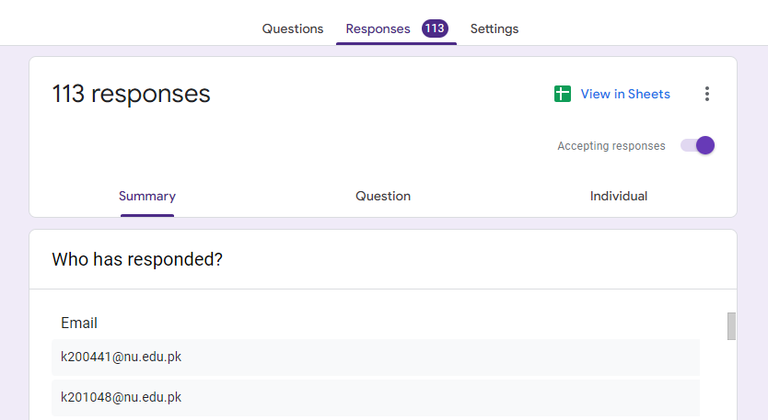
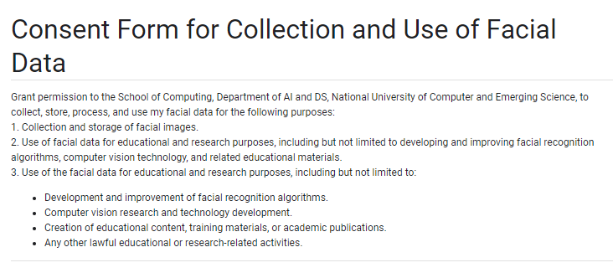
Dataset Preparation – Consent Form

Slide 6
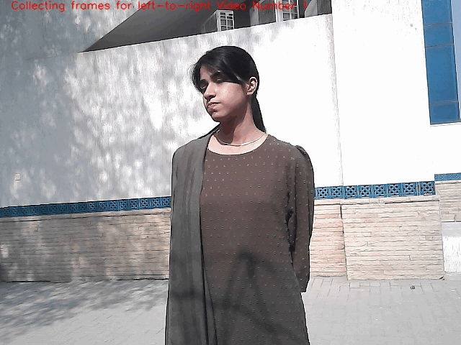

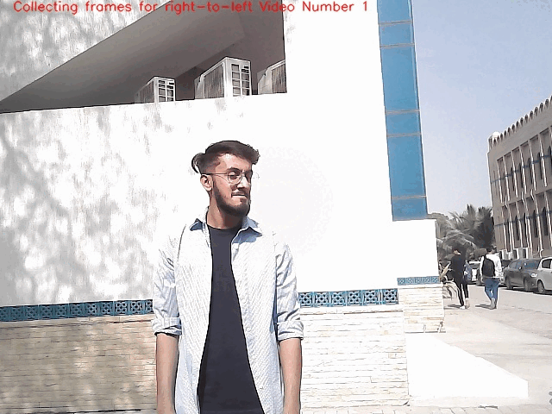



Dataset Preparation
Left To Right
Random
Right To Left

Slide 7
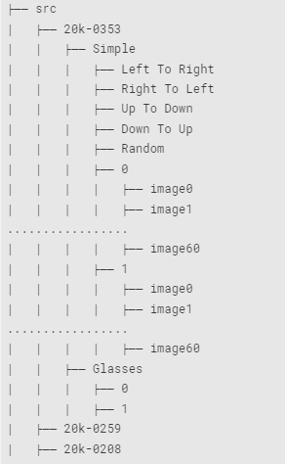





Dataset Preparation
Down To Up
Random
Left To Right
Right To Left
Up To Down

Slide 8
Results – Confusion Matrix
Model | Face Present | Face Absent
Algorithm Detects Face | Algorithm correctly identifies a face | Algorithm incorrectly identifies a non-face object as a face
Algorithm Does Not Detect Face | Algorithm fails to detect a real face | Algorithm correctly does not identify a face where there is none
Model | Face Present | Face Absent
Algorithm Detects Face | TP | FP
Algorithm Does Not Detect Face | FN | TN

Slide 9
Results – Confusion Matrix
Yolov8 | Face Present | Face Absent
Algorithm Detects Face | 15523 (TP) | 189 (FP)
Algorithm Does Not Detect Face | 323 (FN) | 273 (TN)
Dlib | Face Present | Face Absent
Algorithm Detects Face | 4599 (TP) | 2 (FP)
Algorithm Does Not Detect Face | 4757 (FN) | 292 (TN)
OpenCV | Face Present | Face Absent
Algorithm Detects Face | 4388 (TP) | 8345 (FP)
Algorithm Does Not Detect Face | 2194 (FN) | 75 (TN)

Slide 10
Results - Summary
Model | Accuracy | Precision | Recall | F1-Score
Yolov8 | 0.968604365 | 0.987970977 | 0.979616306 | 0.983775904
Dlib | 0.506839378 | 0.999565311 | 0.491556220 | 0.659024145
Open-CV | 0.297493667 | 0.344616351 | 0.666666666 | 0.454361894

Slide 11
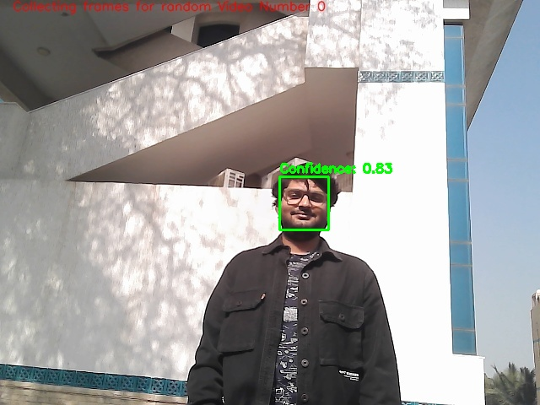
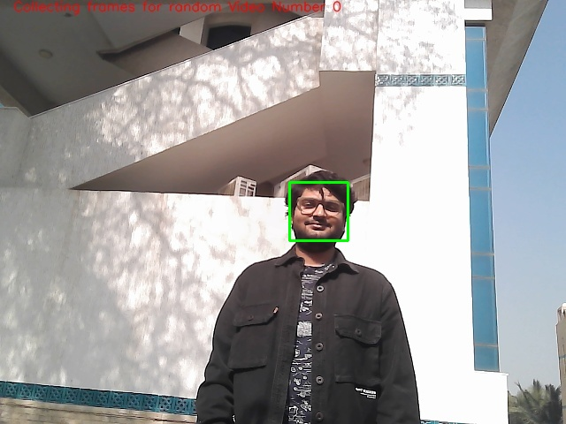

Comparison – All 3 Models
Yolov8 True Positive
OpenCV True Positive
Dlib True Positive

Slide 12
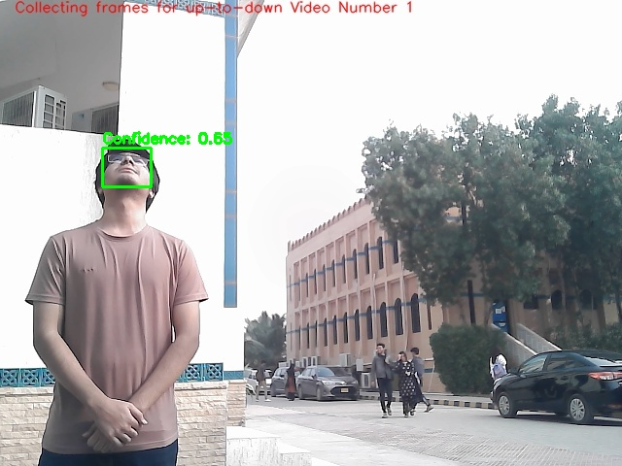
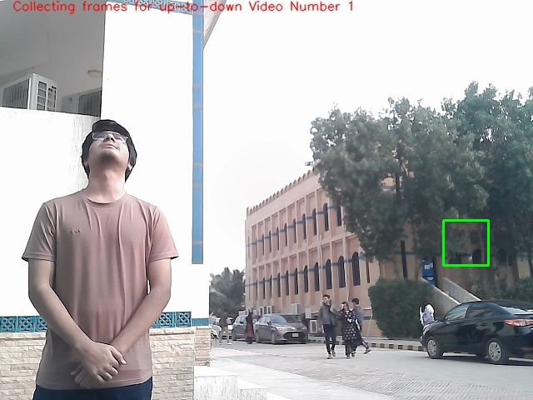
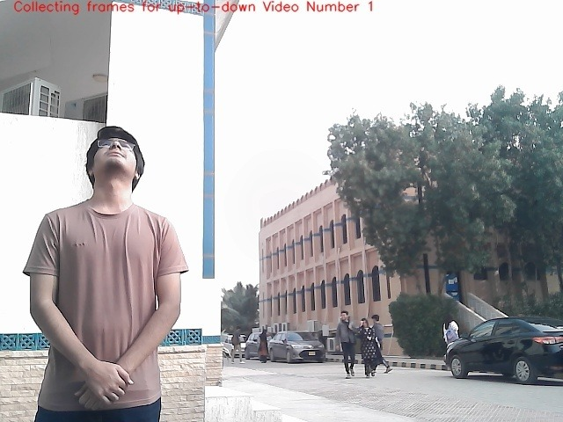
Comparison – Background Captured
Yolov8 True Positive
OpenCV False Positive
Dlib False Negative

Slide 13
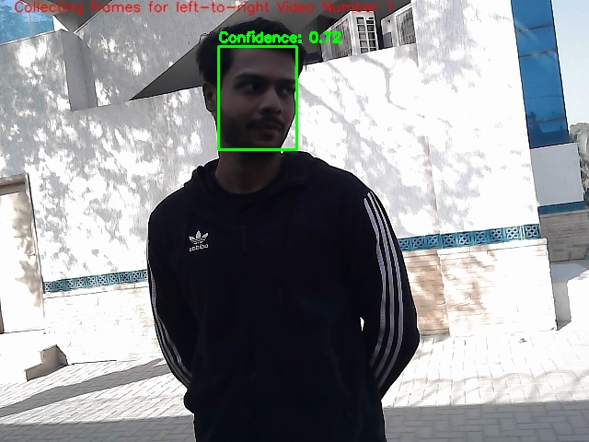
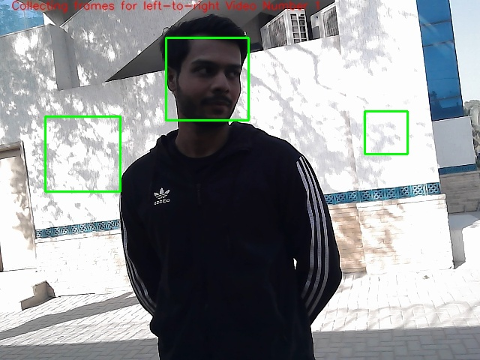
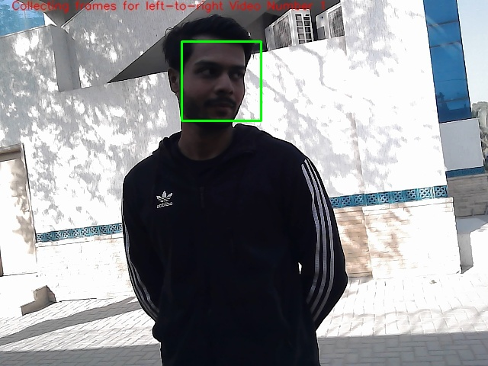
Comparison - Background Captured
Yolov8 True Positive
OpenCV False Positive
Dlib True Positive

Slide 14
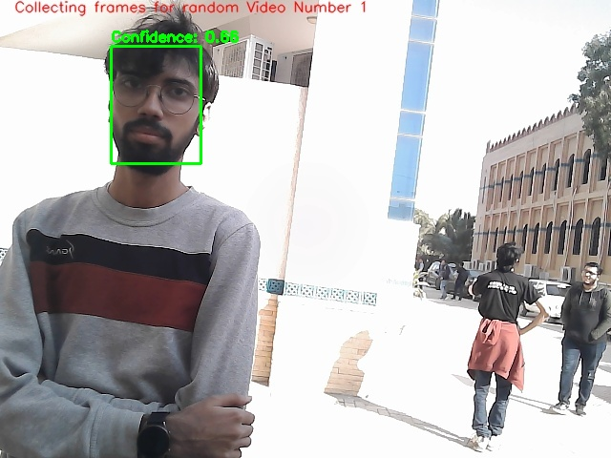
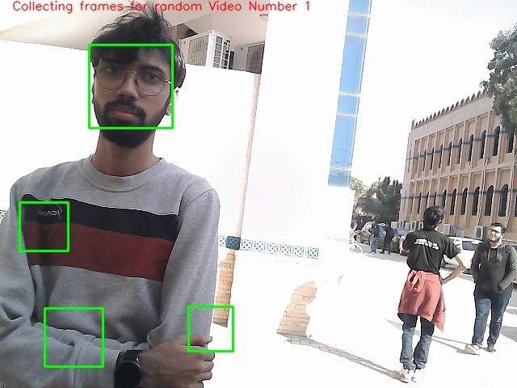
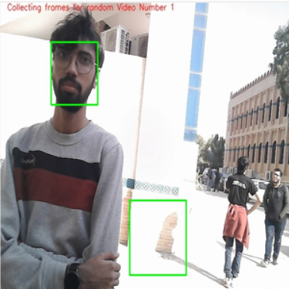
Comparison
Yolov8 True Positive
OpenCV False Negative
Dlib False Positive

Slide 15
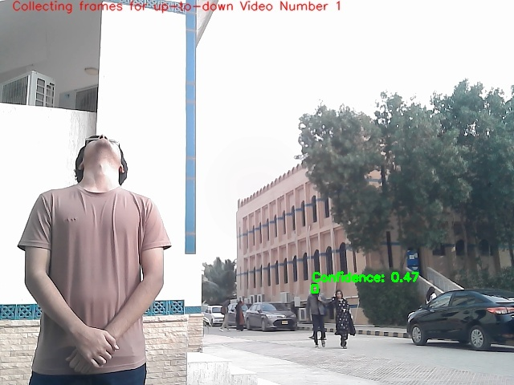
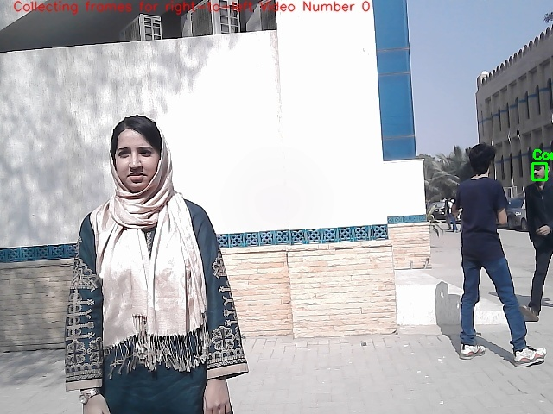
Comparisons – Yolov8?
Yolov8 False Positive
Yolov8 False Negative
Notes:
Develop an efficient face recognition system tailored for Fast University students.
Seamlessly integrate the face recognition system with hardware, enabling user entry control through a green LED light signal.
Establish a benchmark dataset to facilitate future research, fostering exploration and advancement in the field of facial recognition.

Slide 16
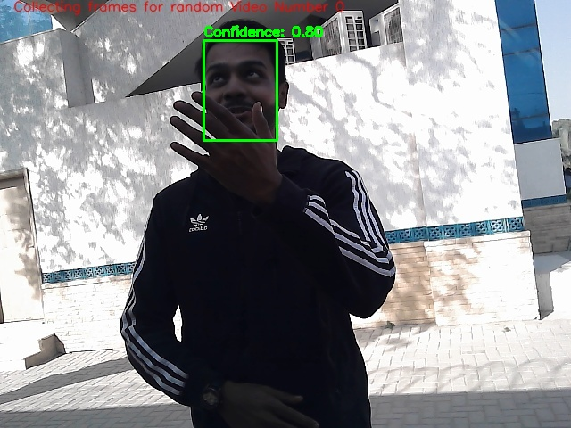
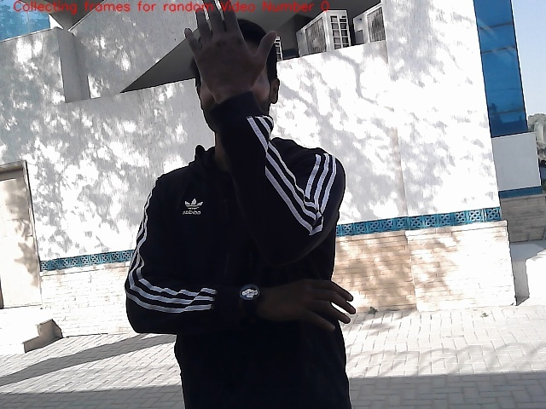
Comparisons – Yolov8 True Negative
Yolov8 True Positive
Yolov8 True Negative
Notes:
Develop an efficient face recognition system tailored for Fast University students.
Seamlessly integrate the face recognition system with hardware, enabling user entry control through a green LED light signal.
Establish a benchmark dataset to facilitate future research, fostering exploration and advancement in the field of facial recognition.

Slide 17
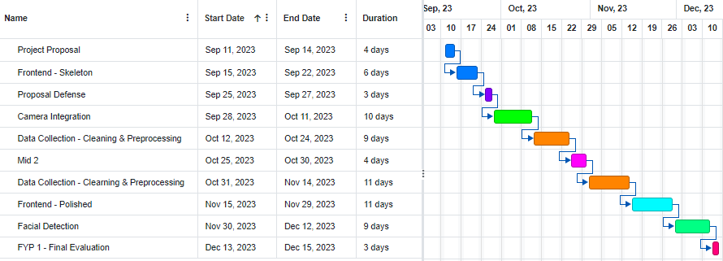
Timeline – FYP 1

Slide 18
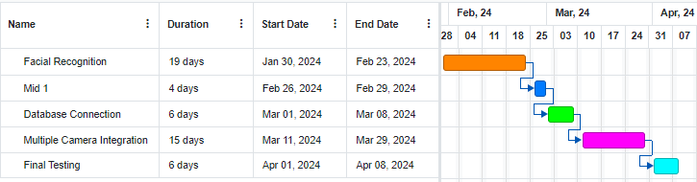
Timeline – FYP 2

Slide 19

Any Questions?

Slide 20


